Slide 1
Analytics Programming and Data Visualisation
CRIME AND RENT ANALYTICS IN IRELAND
Henrique Carlos da Silva Ricardo
Ohifeme Daniel Tijesu
A project examining the relationship between recorded crime offences and rental prices across Irish countries.

Slide 2
Recording
Analytics Programming and Data Visualisation-20251209_154720-Gravação da Reunião.mp4

Slide 3




Problem & Motivation
Our motivation stands from the significant socio-economic challenges currently faced in Ireland: the high and ever increasing rate of housing costs and the rising crime rates.

Slide 4

Research Question & Objectives
To what extent is there a relationship between recorded crime levels and rental prices across Irish countries over time?
Key Objectives:
Build a complete data engineering system integrating the Crime and Rental datasets.
Create a single, consolidated database on the county and year level.
Create an interactive Streamlit dashboard.
Provide clear answers on how crime and rent data correlate across counties and time periods.

Slide 5


Data Sources
CSO Recorded Crime Offences: Official crime statistics by county and year with incident counts by type in CSV file.
RTB Rent Index: Private rental market prices by region and quarter in JSON format.
Both datasets contain 2000+ rows.

Slide 6
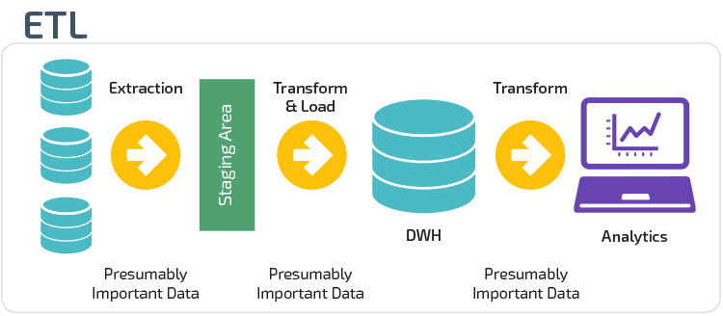




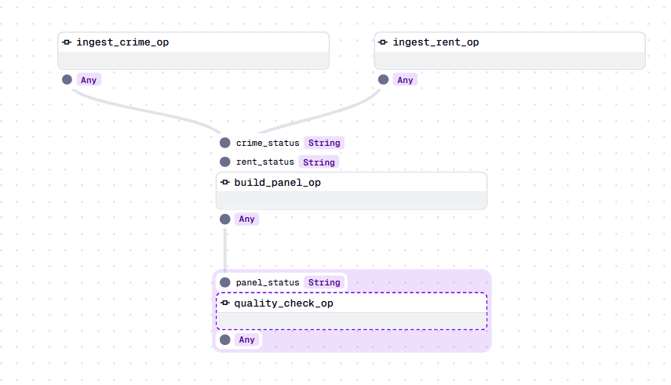
ETL Pipeline & Architecture
Data Sources
Extract
Transform
Load
Analytics
Extract: read crime_data.csv and rent_data.json using pandar and json libraries.
Transform: Standardize columns, map Garda divisions to counties, filter years, aggregation to county-year level.
Load: Write cleaned tables to PostgreSQL, save metadata to MongoDB, build crime_rent_panel
Orchestrate: Use Dagster to define ops and jobs, monitor execution via web UI

Slide 7
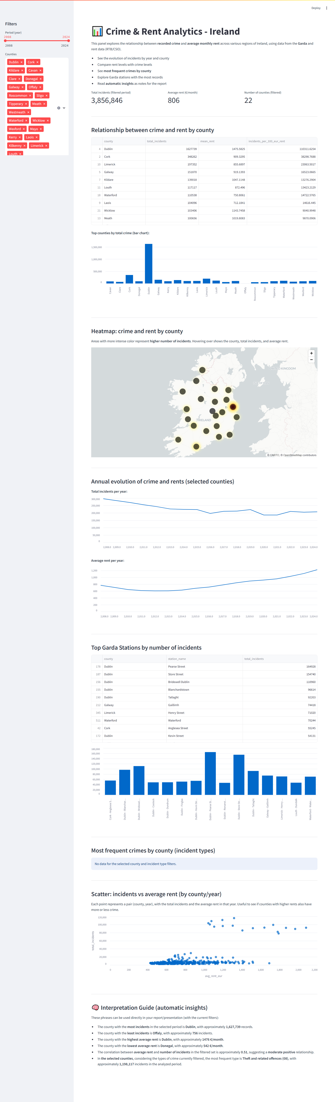

Dashboard Design & Functionality
Geospatial Heatmap
Metrics Header
Time Series Analysis
Correlation Analysis

Slide 8
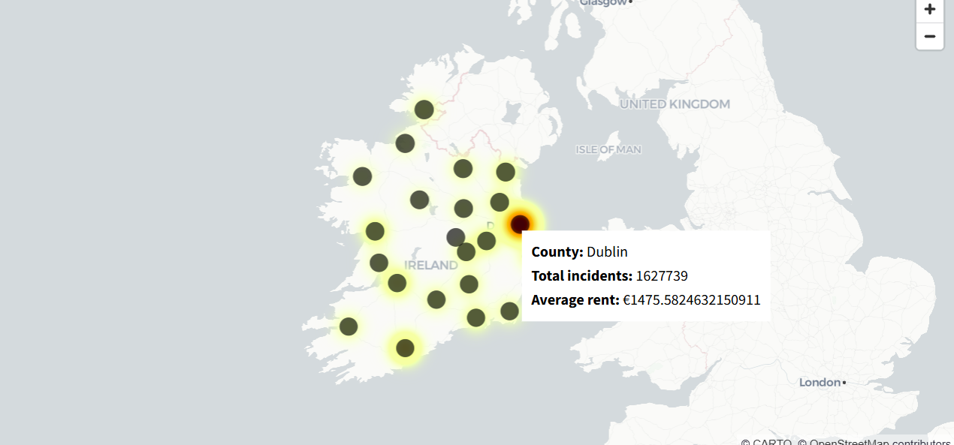
Key Findings
0.51
Correlation Coefficient
300+
Data Points
Weak to moderate positive correlation between crime and rent across all countries (2008-2024)
County year observations in final integrated dataset.
22
Counties Analysed
Comprenhensive coverage across Ireland from 2008 to 2024
Dublin exhibiting the highest level of crime heat and rent. Regional cities like Cork, Galway and Limerick are observed as secondary hotspots. Lower Incidents and rents were found in Rural Counties.

Slide 9
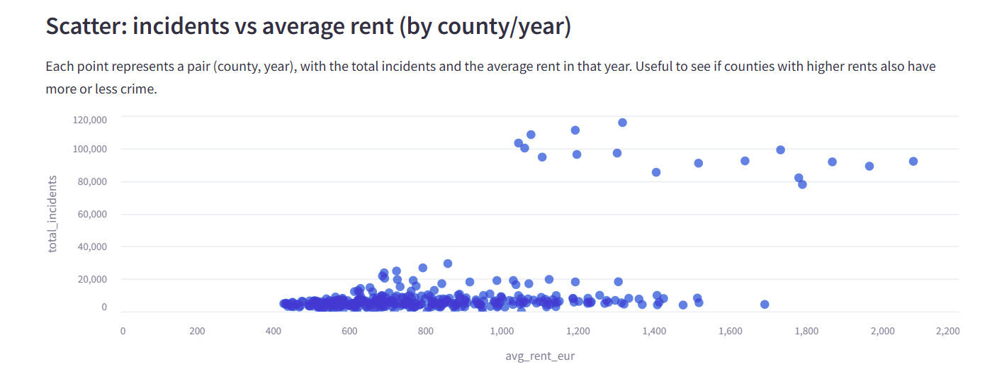
Key Insights
0.51
Correlation Coefficient
300+
Data Points
Weak to moderate positive correlation between crime and rent across all countries (2008-2024)
County year observations in final integrated dataset.
22
Counties Analysed
Comprenhensive coverage across Ireland from 2008 to 2024
Counties with higher rent (Dublin, Cork, Galway) also report more incidents, but the relationship is influenced by population density and urbanization rather than direct causation.

Slide 10
Key Insights
2008 Peak: Most countries show peak incidente levels around 2008.
2014 Onwards: RTB Index shows steady rental price increases after 2014.
Variable Patterns: Crime rates fluctuation could be due to policy and policing changes.
Smooth Growth: Rental increases appear more predictable.
Crime fluctuations are more variable than rental trends, suggesting different underlying drivers including policy changes, policing strategies and reporting practices.
Weak to moderate positive correlation.
It’s highly likely that mediating factos, such as population density, socio-economic composition, and policing policiesm influence both the cost of rent and the number of crimes commited and reported.

Slide 11
Limitations & Future Work
Current Limitations | Future Enhancements
County level aggregation masks neighborhood level associations. | Incorporate Census data for additional socio-economic indicators
Missing socio-economic variables(income, unemployment. migration) | Implement time series models and panel regression analysis
Manual mapping required for Garda Stations to countries. | Add predictive Analytics for crime forecasting
Correlation does not imply causation. | Deploy on cloud platform for automated workflows

Slide 12

Conclusion
Engineering Success
Analytical Insights
Demonstrated effective integration of PostgreSQL, MongoDB, Dagster, and Streamlit for reproducible data pipeline
Weak positive correlation (r=0.51) between crime and rent, with urbanization as likely mediating factor
Stakeholder Value
Interactive dashboards enables Gardaí and policymakers to explore evidence based patterns in crime and housing.
This project showcases the potential of combining open datasets, modern data engineering practices, and interactive visualization to facilitate evidence-informed debates on crime and housing intersections in Ireland.

Slide 13
THANK YOU

